Slide 1
Object-Oriented Design
Assignment 1 (Use Cases)
By: Group 13
Nopphiphat Suraminitkul (Nopi)
Ayush Singh
Juhi Sinha
Somnath Jogelkar

Slide 2
List of Actors
System (Application): The job of the system is to grant all the actors, including the moderator, family & friends and movie server access/permission to execute use cases/tasks.
Moderator (Admin): Moderator is the actor who is taking care of all the administrative tasks. That includes inviting people to join a group, managing polls, populate movie list to name a few.
Friends & Family (Participants): We are combining both friends & family as one actor where they essentially serve as customers in the group. As a part of their functionality they shall join the group, browse the movies, vote for movies to name a few.
Movie Server API: An API to pull the movie list from. The movie server has the movie list that will be populated by the moderator.

Slide 3
List of Use Cases (Moderator)
Moderator creates group: The moderator shall create a movie watcher’s group.
Moderator sends invitation: The moderator shall send an invitations to family and friends to join the group that they are invited to.
Moderator pull movies list: The moderator shall extract a list of movies that the family and friends shall browse from an external movie server. It’s similar to the process of extraction in an ETL process
Moderator populate movie links: The moderator shall populate the movies list (including links) into the group for family and friends to browse or search.
Moderator populate movie trailer links: The moderator shall populate the movie trailers links along with movies list into the group for family and friends to browse or search and watch.
Moderator populate movie review links: The moderator shall populate the movie review links along with movies list into the group for family and friends to browse or search and read.
Moderator create movie watching event: The moderator shall create a movie watching event that already has a pre-specified date and time of movie screening.
Moderator opening polling periods: The moderator has the ability to set (open) polling time frame for a specific poll posted under a movie watching event.
Moderator closing polling periods: The moderator has the ability to set (close) polling time frame for a specific poll posted under a movie watching event.

Slide 4
List of Use Cases (Family & Friends)
Family & friends join group : Family & friends shall accept the invitation to join a group.
Family & friends unsubscribe from group : Family & friends shall be able to unsubscribe from the group.
Family & friends search movies : Family & friends shall be able to search a particular movie from the list of movies.
Family & friends watch trailers : Family & friends shall be able to watch a trailer after they select a particular movie from the list of movies.
Family & friends read movie reviews : Family & friends shall be able to view the review after they select a particular movie from the list of movies.
Family & friends get polling notification : Family & friends shall receive a polling notification for the list of movies.
Family & friends vote for movie : Family & friends shall be able to vote for a particular movie from the list of movies.
Family & friends modify vote : Family & friends shall be able to modify their votes during the polling period before the pre-specified closing date and time.
Family & friends get winner notification : Family & friends shall be notified of the movie that won the poll.
Family & friends access movie history : Family & friends shall be able to access their history of movies viewed.

Slide 5
List of Use Cases (Movie Server)
Movie Server Grants Access to List of Movies: Movie Server gives access of the list of movies to the moderator

Slide 6
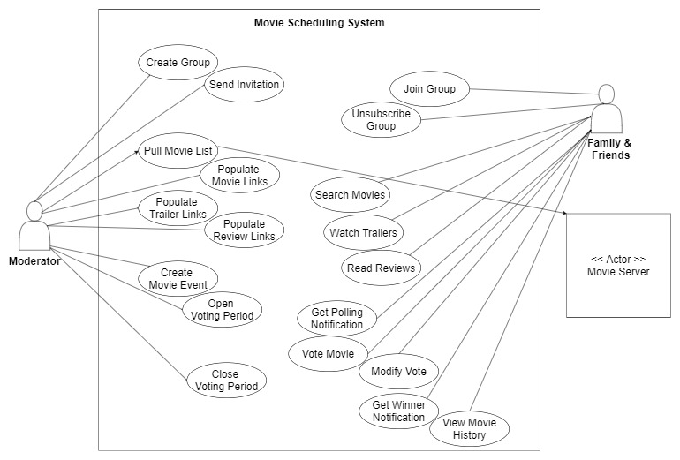
Use Case Diagram (old)

Slide 7
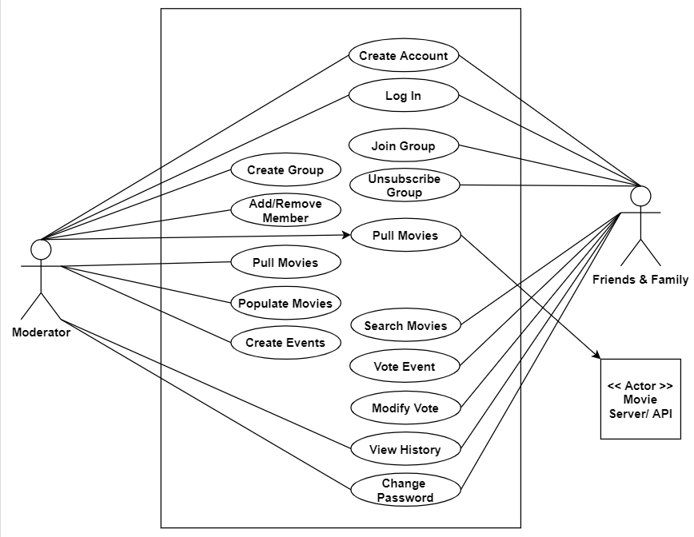
Use Case Diagram (new)

Slide 8
Use Case: Create Account
Use Case Name and Number : “Create Account” with UCID : 1.
Date : {Last Updated On}.
Summary : Both “Moderator” and “Friends & Family” will create an account for themselves in the system.
Assumptions: “Create account” can be used by Moderator and Friends & Family only once. The “Create Account” section is on the homepage itself with form validation feature.
Actor : “Moderator” and “Friends & Family”.
Precondition:
All the actors have to be connected to the internet.
They have to navigate to the system.
Description: The use case begins when the actor is connected to the internet with their device. Actors will navigate to the system by putting in the correct URL or opening up the application on their devices. Actors see the homepage of the system where they will choose to create an account by inputting their credentials. The use case will end when they are able to successfully hit the “Create Account” button.
Exceptions:
The actors are not able to connect to the internet.
The system is down for maintenance.
The “Create Account” button does not work and crashes the system.
Post Condition: System has allowed the actors to input their credentials and create an account for themselves.

Slide 9
Use Case : Log in
Use Case Name and Number : “Login” with UCID : 2.
Date : {Last Updated On}.
Summary : Both “Moderator” and “Friends & Family” will login to their accounts for themselves in the system.
Assumptions: “Login” option can be used by Moderator and Friends & Family multiple times. One email can only be used for creating one account.
Actor : “Moderator” and “Friends & Family”.
Precondition:
All the actors have to be connected to the internet.
They have to navigate to the system.
All the actors need to have an account already created in the system.
All actors need to know their email and password
Description: The use case begins when the actor is connected to the internet with their device and will navigate to the system. Actors see the homepage of the system where they will choose to login by inputting their credentials. The use case will end when they are able to login to their account successfully and land on the homepage.
Exceptions:
The actors are not able to connect to the internet.
The actors forgot the password and need to reset it.
The “Login” button does not work and crashes the system.
Post Condition: System has allowed the actors to input their credentials login to their account and land on homepage..

Slide 10
Use Case : Create Group
Use Case Name and Number : “Create Group” with UCID : 3.
Date : {Last Updated On}.
Summary : “Moderator” will create a group where they will select the users for invitation.
Assumptions: “Login” option can be used by Moderator and Friends & Family multiple times. One email can only be used for creating one account.
Actor : “Moderator” and “Friends & Family”.
Precondition:
All the actors have to be connected to the internet.
They have to navigate to the system.
All the actors need to have an account already created in the system.
All actors need to know their email and password
Description: The use case begins when the actor is connected to the internet with their device and will navigate to the system. Actors see the homepage of the system where they will choose to login by inputting their credentials. The use case will end when they are able to login to their account successfully and land on the homepage.
Exceptions:
The actors are not able to connect to the internet.
The actors forgot the password and need to reset it.
The “Login” button does not work and crashes the system.
Post Condition: System has allowed the actors to input their credentials login to their account and land on homepage.

Slide 11
Use Case : Change Password
Use Case Name and Number : “Change Password” with UCID : 4.
Date : {Last Updated On}.
Summary : Both “Moderator” and “Family and Friends” can change their password for login, should they need to.
Assumptions: “Change Password” option can be used by Moderator and Friends & Family multiple times. The password can be changed for the account that has already been registered.
Actor : “Moderator” and “Friends & Family”.
Precondition:
All the actors have to navigate to the system.
All the actors need to have an account already created in the system.
All actors should be logged-in in order to change their password.
All the actors need to know their previous password in order to change it.
Description: The use case begins when the actor is connected to the internet with their device and will navigate to the system. Actors need to log in to their accounts with their email id and their pre existing password. They must click on the “Change Password” option available in the drop down list of the “User” tab . The use case will end when they will input the old password, new password and to click on the “Change Password” button.
Exceptions:
The actors forget their old password.
The actors cannot login to the system with their email.
The “Change Password” button does not react the way it is supposed to be and crashes the website on user’s end.
Post Condition: System has allowed the actors to input their old password, new password that they wish to set and updates the password for their account.

Slide 12
Use Case: Add/Remove Member
Use Case Name and Number : “Add/Remove Member” with UCID : 5.
Date : {Last Updated On}.
Summary : Only “Moderator” of the group has the privilege to add/remove a member from a group.
Assumptions: “Add/Remove” option can be used by moderator multiple times. The add option is available for those users that are not part of the selected group. The remove option is available for users who are already a part of the selected group.
Actor : “Moderator”.
Precondition:
Moderator have to navigate to the system.
Moderator should be logged-in in order to add or remove members.
Moderator must choose new members or remove members which already have an account in the system.
Description: The use case begins when the moderator has logged into their account. Moderator must click on “Groups” tab on the top navigation bar in order drop down and click on “Edit Group” option. They will be redirected to a page where they have 2 buttons with “Add” and “Remove” label on them. Moderator can click on the add button to add users that are not part of the selected group. Moderator can click on the “Remove” button to remove users who are already a part of the selected group. The use case ends with Moderator either adding new members or removing existing members from a selected group.
Exceptions:
Moderator cannot login to the system with their email.
All the users are already a member of a selected group, hence the moderator cannot add anyone else.
There is no member in the selected group available to be removed by the moderator.
Post Condition: System has allowed the moderator to select users to add and members to remove from a group and hence, the users have been added and members have been removed from the group.

Slide 13
Use Case: Delete Group
Use Case Name and Number : “Delete Group” with UCID : 6.
Date : {Last Updated On}.
Summary : Only “Moderator” of the group has the privilege to delete a group.
Assumptions: “Delete Group” option can be used by moderator once for every group. The “Delete Group” option is available for moderator to choose for the group which has no reason to exist anymore.
Actor : “Moderator”.
Precondition:
Moderator have to navigate to the system.
Moderator should be logged-in in order to see all the groups available.
The group must exist, with or without any members, for the moderator to delete.
Description: The use case begins when the moderator has logged into their account. Moderator must click on “Groups” tab on the top navigation bar in order drop down and click on “Edit Group” option. They will be redirected to a page where they have a button with “Delete Group” label on it. Moderator can choose from the given list of selected groups to delete from. The use case ends with Moderator deleting the group from the system, notifying the users that their group has been deleted.
Exceptions:
Moderator cannot login to the system with their email.
There is no group in the list of groups available to be deleted by the moderator.
The “Delete Group” button does not work and crashes the website on moderator’s end.
Post Condition: System has allowed the moderator to select a group from the given list of groups and hence, the moderator has deleted the group which did not have a reason to exist anymore.

Slide 14
Use Case: Join Group
Use Case Name and Number : “Join Group” with UCID : 7.
Date : {Last Updated On}.
Summary : “Friends & Family” are accepted the invitation to join group created by “Moderator” of the system.
Assumptions: “Join Group” can be used by interested members of “Friends & Family” to join movie watching group that were created by “Moderator” of the system.
Actor : “Friends & Family”.
Precondition:
The “Friends & Family” are users of the system.
The “Friends & Family” email are selected and included in group creation detail when “Moderator” created the group.
The “Friends & Family” are notified of the group invitation, and decided to be part of the group.
Description: The use case begins when the “Moderator” sends invitation to chosen candidates of the group. “Friends & Family” will be notified of the group invitation, and has to decide if they are interested to be members of the group. If interested and chose to accept the invitation, their details will be added to the group. The use case will end when their details are included inside the newly created group, and they become part of the group..
Exceptions:
The details of chosen candidate are incorrect, and the invitation was not sent to the chosen candidate.
The chosen candidate did not accept the group invitation due to reasons such as not interested, to name a few.
Post Condition: “Friends & Family” who have accepted to be part of the group has become members of the group, and thus have accessed to functionalities such as “voting” and “history”, to name a few.

Slide 15
Use Case: Unsubscribe Group
Use Case Name and Number : “Unsubscribe Group” with UCID : 8.
Date : {Last Updated On}.
Summary : “Friends & Family” members of the group decided to leave the group.
Assumptions: “Friends & Family” are not interested to remain members of movie watching group.
Actor : “Friends & Family”.
Precondition:
The “Friends & Family” are members of the group.
The “Friends & Family” members are not interested in remaining part of the group, and decide to leave..
Description: The use case begins when the “Friends & Family” who are users of the movie watching group decides to leave their current group, and press “Unsubscribe Group”. The use case will end when the System receives notification that the member decides to leave the group, and removes the access of the member to the group.
Exceptions:
The details of member are not successfully removed from the group.
Post Condition: “Friends & Family” who have previously been part of a group has loses access to their previous group.

Slide 16
Use Case: Search Movie
Use Case Name and Number : “Search Movie” with UCID : 9.
Date : {Last Updated On}.
Summary : Both “Moderator” and “Friends & Family” can search for a movie for themselves in the system.
Assumptions: “Search Movie” can be used by Moderator and Friends & Family. The “Search Movie” option is on the right hand side corner of the movies page.
Actor : “Moderator” and “Friends & Family”.
Precondition:
They have to navigate to the system.
There has to be a list of movies available in the system.
Description: The use case begins when the actor navigates to the movies page. Actors will navigate to the system by clicking on the movies page and then clicking on “search movies” button. Actors type in the name of the movie they are looking for and hit enter. Actors see the movie page of the system with only the movie that was found on searching through the system database. The use case will end when they are able to successfully find the movie.
Exceptions:
The “Search Movie” button does not work and crashes the system.
The Actors misspell the movie name.
There are no movies in the list of movies available to be searched for by the actors.
Post Condition: System has allowed the actors to input their desired movie name and search for it from the list of available movies.

Slide 17
Use Case: Vote Period
Use Case Name and Number : “Vote Period” with UCID : 10.
Date : {Last Updated On}.
Summary : “Friends & Family” are notified of a “Vote period” created by the “Moderator” of the system.
Assumptions: “Vote period” can be used by “Friends & Family” to vote for a movie that they want to watch during the “Movie watching event”. The “Vote period” is created my the “Moderator”. The “Moderator” has a list of movies that should be up for voting.
Actor : “Moderator” and “Friends & Family”.
Precondition:
The “Moderator” is aware of the start and end time of the “Vote period”.
There has to be a list of movies available in the system.
There has to be at least one group in the system.
Description: The use case begins when the “Moderator” creates an event. “Friends & Family” will be notified of the voting event along with the start and end time of the “Vote period”. The use case will end when a “voting period” event is successfully created.
Exceptions:
There are no movies in the list of movies available to be searched for by the actors.
Post Condition: System has allowed the actors to input their vote for the movie watching event.

Slide 18
Use Case: Modify Vote
Use Case Name and Number : “Modify Vote” with UCID : 11.
Date : {Last Updated On}.
Summary : “Friends & Family” can modify their vote during the “Vote period” which is created by the “Moderator” of the system.
Assumptions: “Modify Vote” can be used by “Friends & Family” to change their vote for a movie that they want to watch during the “Movie watching event”. “Friends & Family” cannot modify their vote after the “Voting Period” has passed. The “Vote period” is created my the “Moderator”.
Actor : “Moderator” and “Friends & Family”.
Precondition:
The “Moderator” has created a “Vote period”.
There has to be a list of movies available in the system.
There has to be at least one group in the system.
“Friends & Family” must have already cast a vote for a movie.
Description: The use case begins when “Friends & Family” wish to change their vote for the movie watching event. “Friends & Family” must click on “Vote Period” option from the “Events” tab. A list of movies for the movie watching event is presented with the vote option. “Friends & Family” update their vote by clicking on the new movie they want to watch during the movie watching event. The use case will end when the updated vote successfully recorded.
Exceptions:
There are no movies in the list of movies available for vote.
Post Condition: System has allowed the actors to modify their vote for the movie watching event.

Slide 19
Use Case: Pull Movies
Case Name and Number : “Pull Movies” with UCID : 12
Date : 02/11/2020
Summary : ”Moderator” pulls movies from an external API into the system in order to populate the movie list for the “Friends and Family” to select and view review links and trailer links
Assumption:
The movie list is available in the API along with the review links and trailer links.
The API contains all the movies that the “Friends and Family” want to choose from
Actor : “Moderator”
Precondition:
The API is available to be fetched.
All the movies have their trailer links and review links updated in the API
Description: The ”Moderator” uses the Pull movies function to fetch movies from an external system into the application and the “Friends and Family” will be able to see the review links and trailer links on the webpage.
Exceptions:
There are no movies in the API to be fetched
Error in fetching the API when the external application is down
Post Condition: Application has pulled the movies into the system and ”Friends and Family” are able to view the list of movies along with their trailers links and review links

Slide 20
Use Case: Populate Movies
Case Name and Number : “Populate Movies” with UCID : 13
Date : 02/11/2020
Summary : ”Moderator” uses the populate movies function to retrieve all the movies that were pulled from an external API into the applications database
Assumption:
The moderator does not wish to add/delete the list of the movies that were pulled from the API
The API contains all the movies that the “Friends and Family” want to choose from
Actor : “Moderator”
Precondition:
The pull movie function was successful in pulling all the movies from an external API
All the movies have their trailer links and review links updated in the API
Description: The “Moderator” needs to retrieve all the movies from the API using the pull movies function and then use populate movies to insert all the movies into the application’s database
Exceptions:
No movies were fetched when the pull movies function was triggered
An error in inserting the values into the database due to database connection issues
Post Condition: The movie list which was fetched from the API was successfully inserted into the applications database

Slide 21
Use Case: Create Event
Case Name and Number : “Create Event” with UCID : 14
Date : 02/11/2020
Summary : ”Moderator” creates an event which will contain the voting period , event name and the date of the event.
Assumption:
“Moderator” decides the voting time window for the movie.
Actor : “Moderator”
Precondition:
The “Moderator” has a list of users in groups to whom the event invite will be sent.
Description: “Moderator” provides the time window within the create event tab along with the event name and date of the event. A voting link is sent to ”Friends and Family” once the event is created by the moderator.
Exceptions:
The voting time window entered by the “Moderator” is invalid.
The same event name already exists.
Post Condition: “Moderator” creates an event with an event name, date of the event and voting time for the event. A link will be sent to the users of the group to vote for the event.

Slide 22
Use Case: View History
Case Name and Number : “View History” with UCID : 15
Date : 02/11/2020
Summary : ”Moderators” and “Family and Friends” view the history of movies that were selected by the “Friends and Family” along with the name, date and number of votes that were given to a movie.
Assumption:
The application has recorded the events created from the system.
Actor : “Moderator” and “Friends & Family”.
Precondition:
The details of previously voted movies is present within the system.
Description: The “Moderator” and “Friends and Family” click on the view history tab and view all the movies which had been selected . The details include the name of the movie, date on which it was selected and the number of votes it received.
Exceptions:
No records were found in the database for the history of movies.
The same event name already exists.
Post Condition: The “Moderator” and “Friends and Family” view the movies which had been selected . The details include the name of the movie, date on which it was selected and the number of votes it received.

